Slide 1

Awaken Your Health Naturally
Holistic Alternatives • Integrative Advocacy • Wellness & Events

Slide 2
HOLISTIC Alternatives
Integrative
Advocacy
Wellness
Events
PTSD, Cancer, opioids and other afflictions threaten all of us globally, Doctors, Care Givers and Big Pharma are realizing that there must be other, more effective ways to confront these epidemics and illnesses.
With the rise of resistance to antibiotics, an ever-increasing environmental overload of stress and anxiety, people need alternatives.
This is where using Holistic Alternatives, finding an Integrative Wellness Advocate, or promoting Holistic Wellness Events can help to educate our communities.

Slide 3
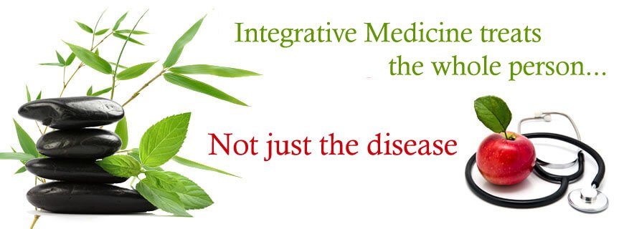
What does Integrative mean anyway ????
Merriam-Webster’s Dictionary defines Integrative as serving to integrate or favoring integration. To integrate means to form, coordinate, or blend into a functioning or unified whole.
Integrative health and wellness is a balanced approach to your mental, emotional, physical and spiritual body systems; it treats all of ‘you’ naturally, or along side of traditional treatments.
Utilizing Holistic Modalities promote lifestyle changes that can help you live a longer, happier life. It does not interfere with medications or any other treatments. Interested?

Slide 4
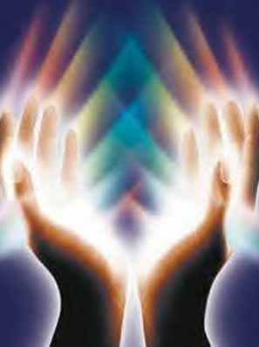
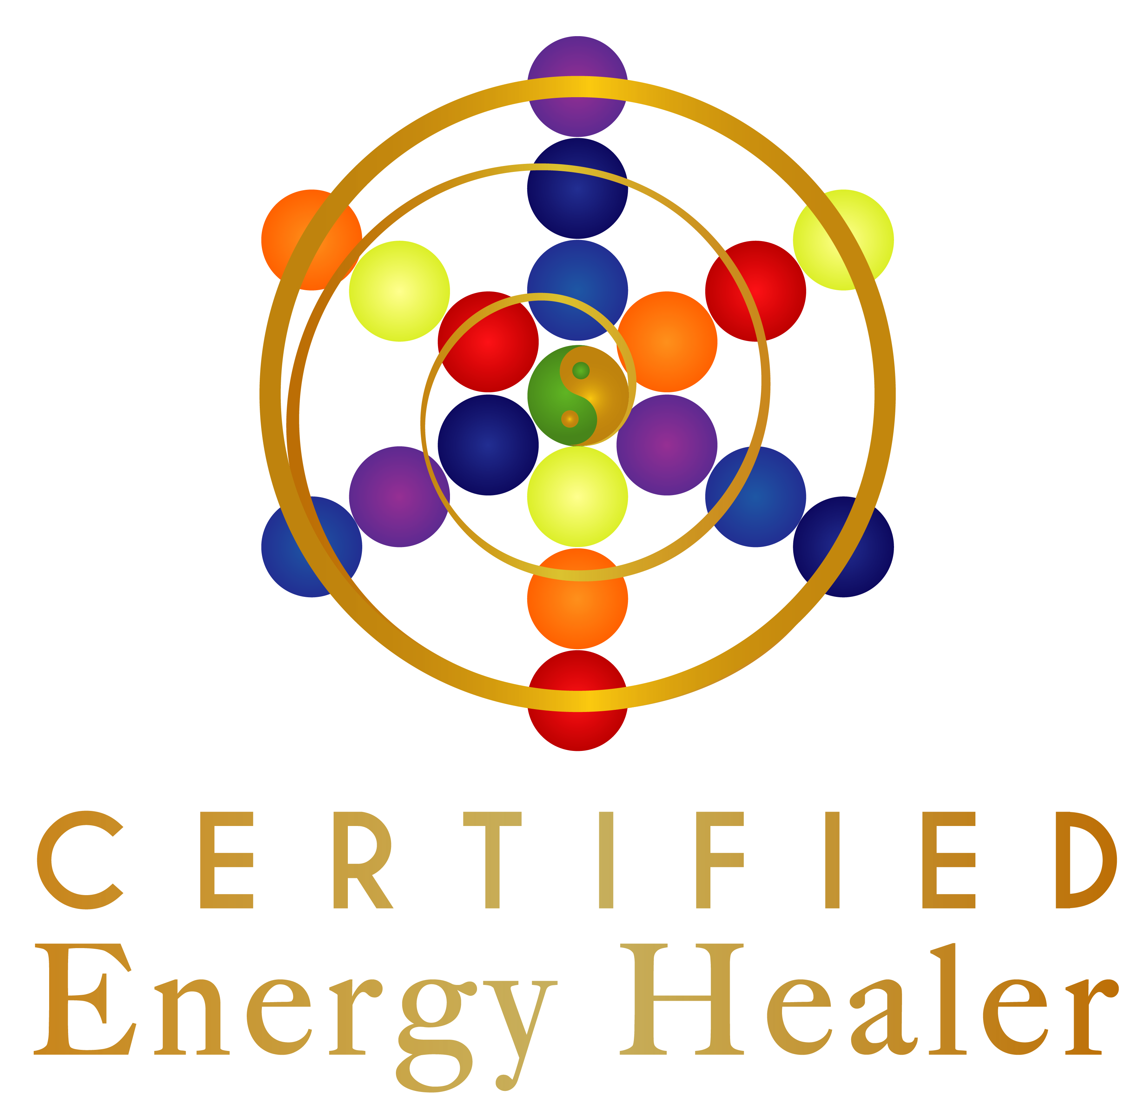
ENERGY WORK
Whether you are asleep, awake, eating, bathing, working or engaging in an activity, you need energy. Energy fuels your body’s internal functions, repairs, builds and maintains cells and body tissues, and fuels the external activities that enable you to interact with the physical world.
The energy within your body can become stagnant from physical, emotional, or environmental circumstances. Blocked energy within your body can cause dis-ease which then can lead to illness.
Energy work is used to restore, realign and help balance your body’s energy centers and will alleviate stress, ailments, and dis-ease.
There are a variety of holistic ways to help rebalance your body.

Slide 5
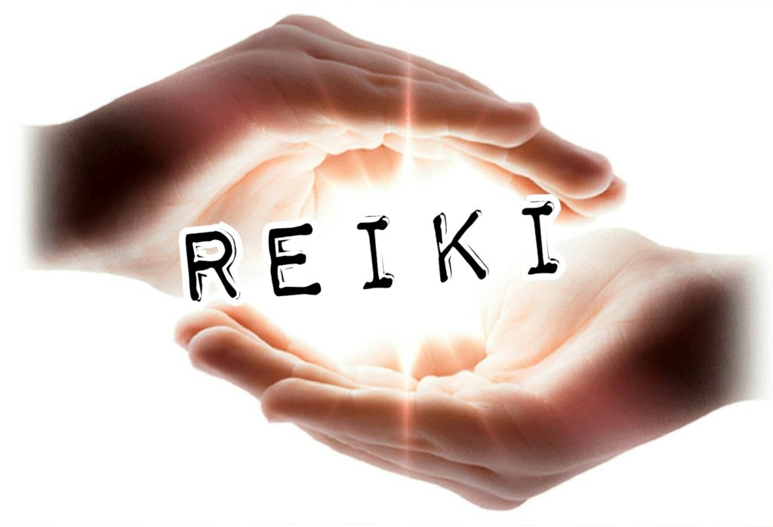
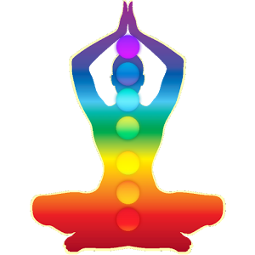
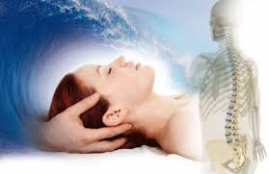
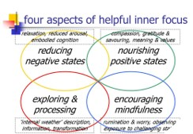
What Alternative's?
Reiki/Energy Work
Mindfulness Coaching
Chakra Balancing
Meridian Clearing
Ask about OTHER Alternatives:
Acupuncture
Reflexology
Craniosacral Therapy
Equine Therapy

Slide 6

Reiki Sessions
$ 40.00 – ½ hour
$ 80.00 – 1 HOUR
$130.00 – 90 minutes
This will be a totally relaxing experience.
Your session will have a therapeutic effect on your mind, body and spirit by helping you open blocked energies.
Reiki works by channeling positive energy into your body where it is needed the most, giving your body a much needed boost.
Reiki aids in relaxation, assisting the body's natural healing processes, and helps with emotional, mental, and spiritual well-being.
When your body is allowed to relax, it can then cope better with difficulties, relieve emotional stress, and improve overall well being.
sole rights of Awaken Your Health Naturally

Slide 7
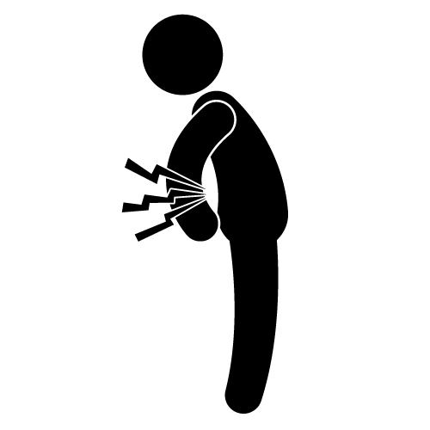
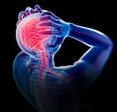
Pain Management & Tension Headaches
Chronic pain is described in many ways, burning, shooting, aching to name a few, and is often accompanied by stiffness, tightness and discomfort. A tension headache can keep you in bed for days.
More practitioners are becoming aware of the proven effects of Reiki when it comes to treating chronic pain or tension headaches. Reiki helps a person find relief from not only the physical aspects of chronic pain but also the anxiety that often comes with it. Reiki treatments work on a deep level allowing relaxation, reduce fatigue and depression, and strengthen a person’s overall sense of wellbeing.
Many clients often first try Reiki when they've "tried everything," yet are still experiencing pain, tension headaches and ongoing stress. This is where energy work can be supportive and greatly improve one's quality of life. Many of my clients first come to me at the suggestion of their physicians, as a complementary service to improve their comfort while receiving traditional treatment.

Slide 8
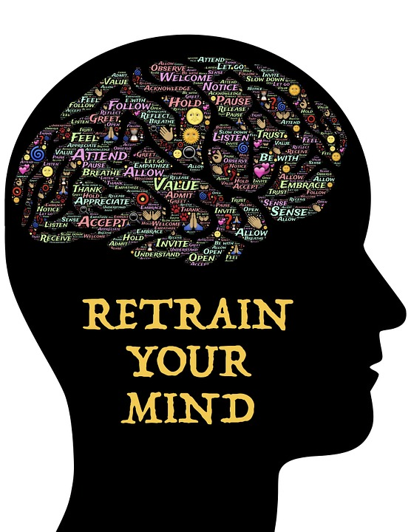
MINDFULLNESS COACHING
Mindfulness is a mental state of awareness, openness and focus.
The regular practice of mindfulness can reduce stress, increase self-awareness, enhance your focus and enable you to handle painful thoughts, feelings, or memories, far more effectively.
Individual or Group
6-8 classes $50.00 per class

Slide 9
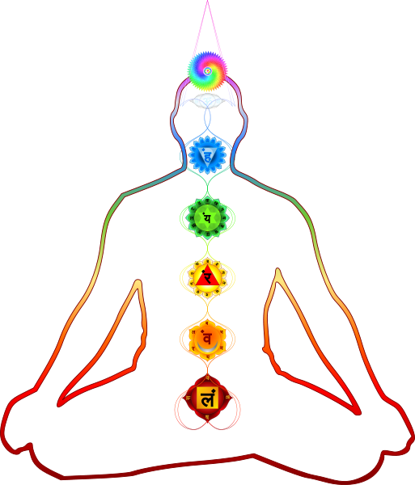
Chakra Balancing
What is a Chakra?
Chakras, by definition, are energy centers within the body that help to regulate all its processes, from organ function to the immune system and emotions. There are seven main chakras positioned throughout your body, from the base of your spine to the crown of your head. Each chakra has its own vibrational frequency, color, and governs specific functions that help make you, well, human.
Chakra balancing promotes health by maximizing the flow of energy in the body, much as a tune-up enables a car to operate at peak efficiency.
Our thinking and our health are inextricably linked with the flow of energy through the chakras.
Eliminating blockages in the energy field allows for an optimal state for healing to occur.
$40.00 - ½ HOUR

Slide 10
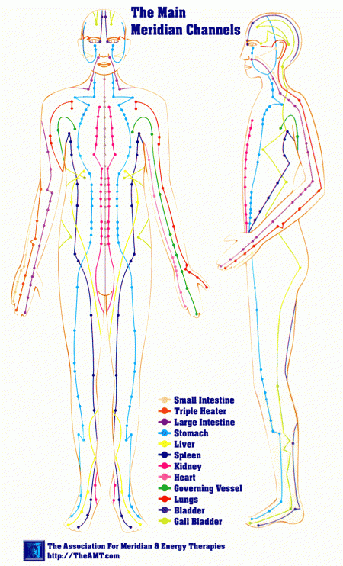
Meridian flush / TRACING
$40.00 – ½ hour
Energy blockages can be the result of stress, an injury or trauma, or bad living habits (diet, habits/addictions, lack of exercise) and can be traced to the root of all health (physical/mental/spiritual) problems.
Our energy flow affects how we feel, how we think, and the over all condition of our health. When the body's energy becomes blocked, various imbalances will result.
The Meridian Flush and Meridian Tracing are very helpful tools we can use the re-establish balance.

Slide 11
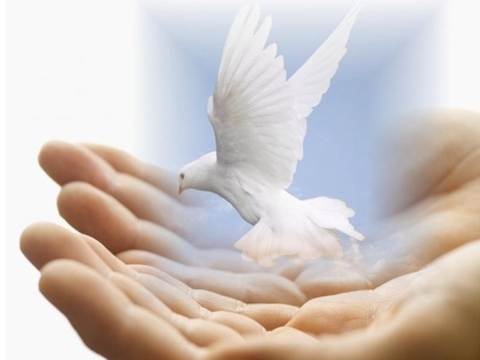
Services
Everyone has different needs. Let’s find what will work for you
•Reiki Session - Energy Clearing Session to reduce stress and promote relaxation
30 minutes $ 40.00
60 minutes $ 80.00
90 minutes $120.00
•Anxiety Reduction & Relaxation Session to help balance and clear energy blockages 60 minutes $80.00
•Chakra or Meridian Evaluation and Balancing Session will include analysis of chakras,(or meridians) and a Reiki treatment to balance and clear blocks and rebalance chakras - 60 minutes $80.00
•Mindfulness Coaching $50.00 per session
•Pet Energy Healing $30.00 per half hour
.

Slide 12
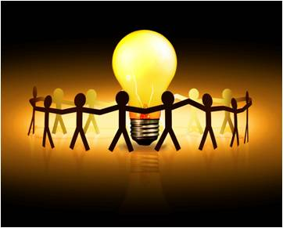
The best way to get the word out is to share what you know ….
Hold at event at your current space or other venue
Educate and reach as many people as you can
Share your story, your passion
Have a guest speaker teach or do a series of talks (ex: essential oils, are CBD products for you, what are the benefits of a Reiki session…
Talk to me about your event

Slide 13

Come and learn something to help heal yourself or a loved one
Holistic Events
Interested in having a Holistic Event?
High quality health & wellness speaker(s)
Holistic Vendors
Learn about what other safe, holistic modalities are available
Form relationships with other like-minded people
Disclaimer: As always …. NEVER DISREGARD PROFESSIONAL MEDICAL ADVICE OR DELAY SEEKING MEDICAL ATTENTION/TREATMENT BECAUSE OF SOMETHING YOU HAVE READ ON OR ACCESSED THROUGH THIS OFFICE, WESITE, PAGE, GROUP tweet, etc. Do not start or stop taking any medications without speaking to your own Medical Provider or Mental Health Provider. Always check with your doctor if you are considering taking any supplements or herbs, as they may interact negatively with certain medications. If you have or suspect that you have a medical or mental health problem, contact your own Medical Provider or Mental Health Provider immediately.

Slide 14
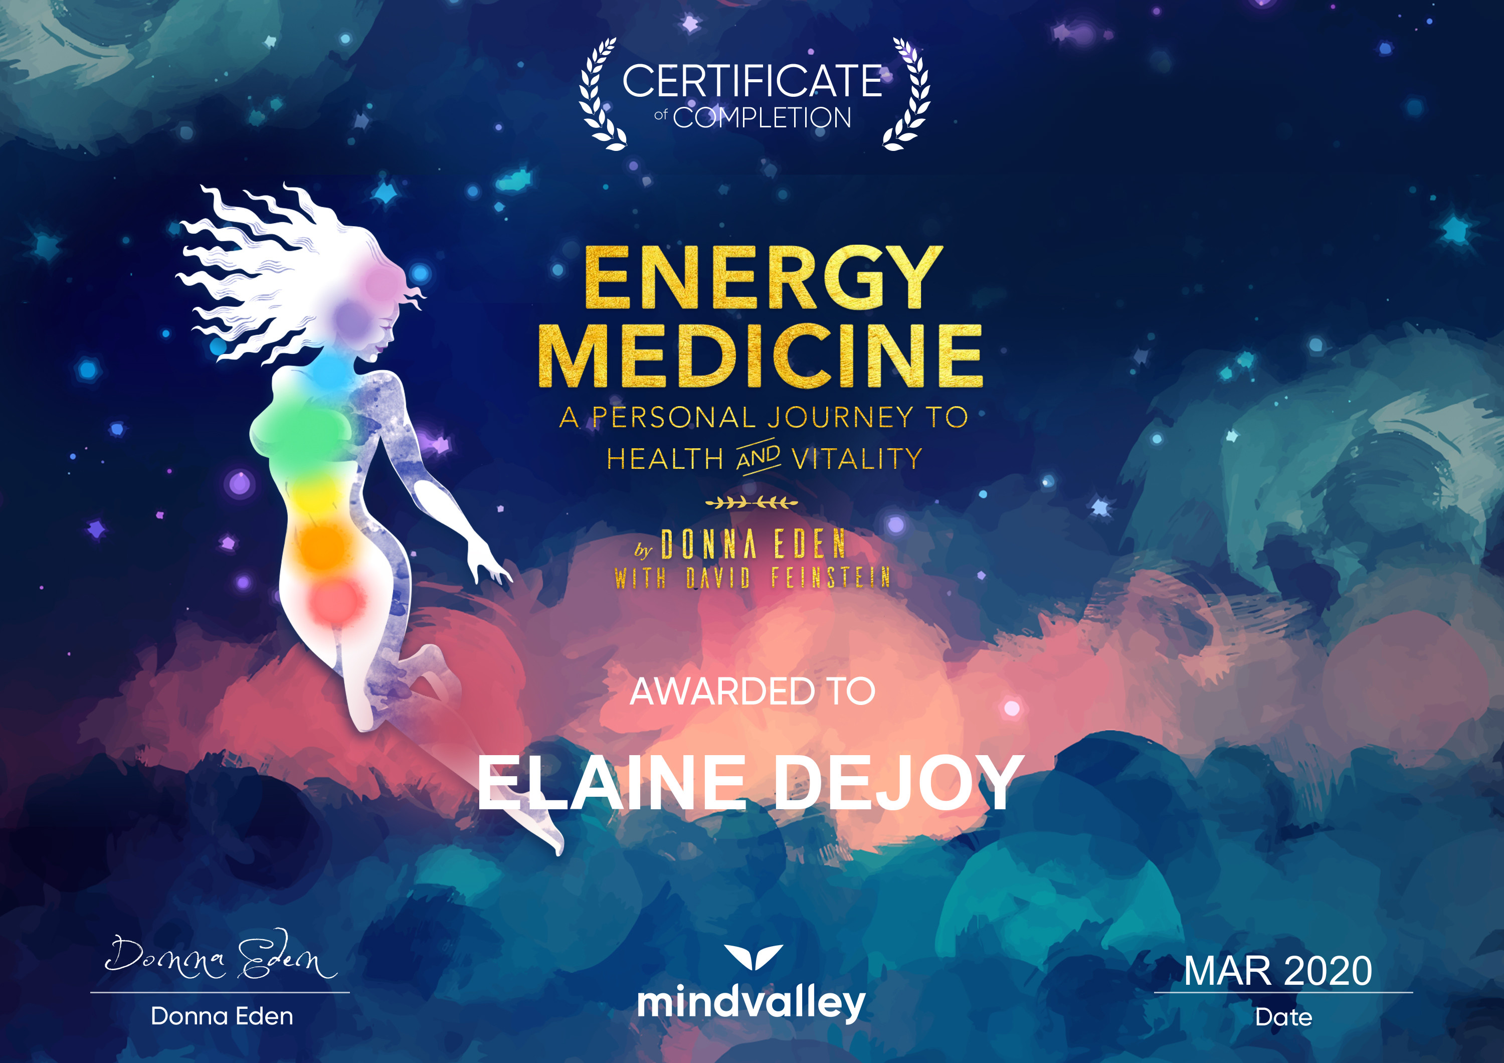

About
Skillfully weaving multi-modalities employing Reiki Energy Healing (Certified Usui Holy Fire II Master & Karuna Holy Fire II Master/Teacher level), Energy Work, Chakra balancing, Meridian clearing, Meditation, Mindfulness Practitioner Certified Coach, Pet Energy and Tru-Hemp Distributor.
Your session will have a therapeutic effect on your mind, body and spirit by helping you open blocked energies. Think of your body as a super human highway; it’s a system that includes major wiring running all throughout your body that connects to your major organs and your entire body is being constantly bombarded by every day living, stress, and your environment.
You are energy. When you are feeling well, you are likely to be and feel happy, healthy, fulfilled, have high energy, and in most instances, avoid illness. When you are not feeling well, you know you have low energy, are sluggish, feeling stuck, get sick and feel more stress. Often the body acts like a magnet, attracting more of what you feel or focus on. Discomfort is meant to get your attention before dis-ease. Releasing toxins and toxic buildup within your body will bring relief to your organs as well as your mind and increase a sense of inner well being thereby feeling more connected to ‘yourself’.
If you suffer from PSTD or addictions, if you are constantly in pain or feel out of sorts, I would ask you, how many things have you tried? Have you ever tried something like this? These modalities treat you in your entirety which includes your body, emotions, mind and spirit thereby generating beneficial effects that include relaxation, peace, security and well being. All these modalities are natural and safe methods of self empowerment with no side affects (except feeling better), nor will they interfere with any medications. These modalities have been effective in helping virtually every known illness and malady and always creates a positive affect.
Just for today, do not anger
Do not worry and be filled with gratitude
Devote yourself to your work. Be kind to people.
Every morning and evening join your hands in prayer.
Pray these words to your heart
and speak these words with your mouth
Usui Reiki Treatment for the improvement of body and mind
The founder, Usui Mikao
Elaine DeJoy –
www.Awakenyourhealthnaturally.com
401-487-9608

